Slide 1
Transformer Architecture

Slide 2
History
Initially, we used Recurrent Neural Networks (RNNs) for sequential data. They worked well but had limitations like vanishing gradients, making it hard to capture long-range dependencies.
Then came Long Short-Term Memory (LSTMs), which solved some of RNNs' problems but were still sequential in nature—slowing down training.
Next, Attention Mechanisms were introduced in sequence-to-sequence models, allowing networks to focus on relevant parts of the input.
Transformers took this idea to the next level, removing recurrence entirely and relying purely on self-attention. This allowed for parallel computation, making training much faster and more efficient.

Slide 3
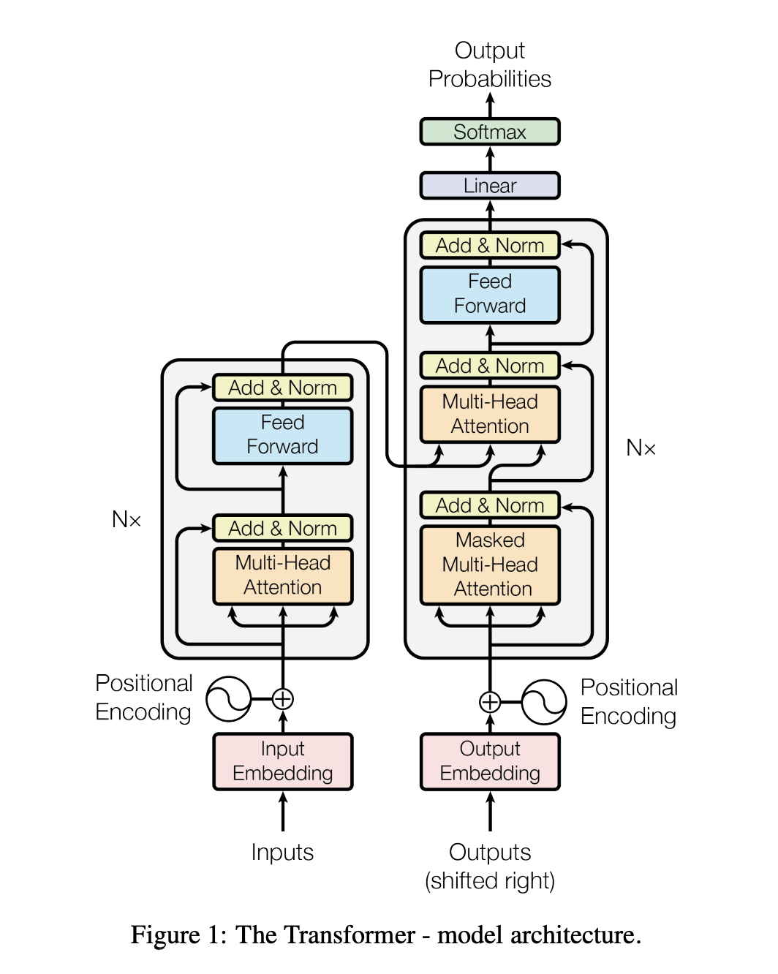

Slide 4
ATTENTION!!!!!
WORD EMBEDDINGS – capture the semantic meaning
They are static embeddings with no context awareness
Contextual embeddings improve by dynamically adjusting word meaning based on context

Slide 5
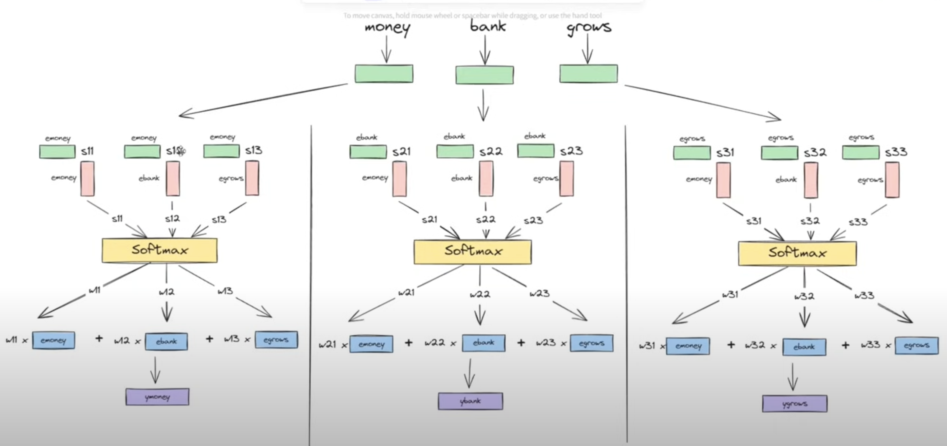

Slide 6
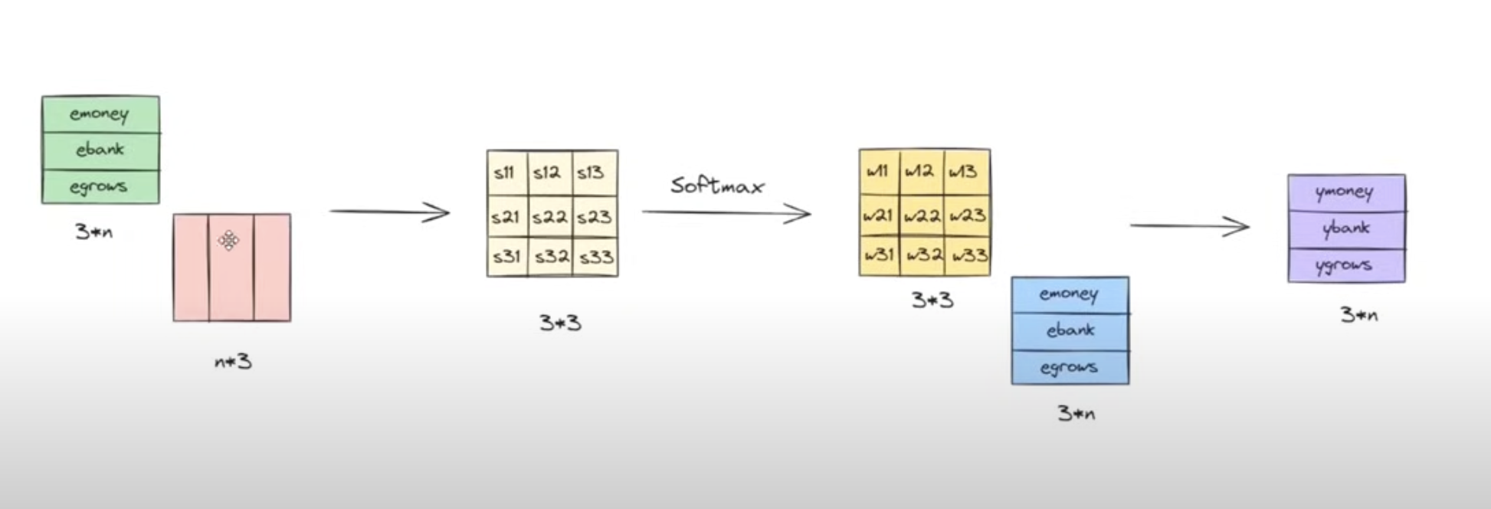
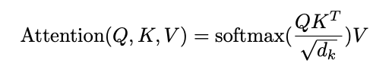

Slide 7
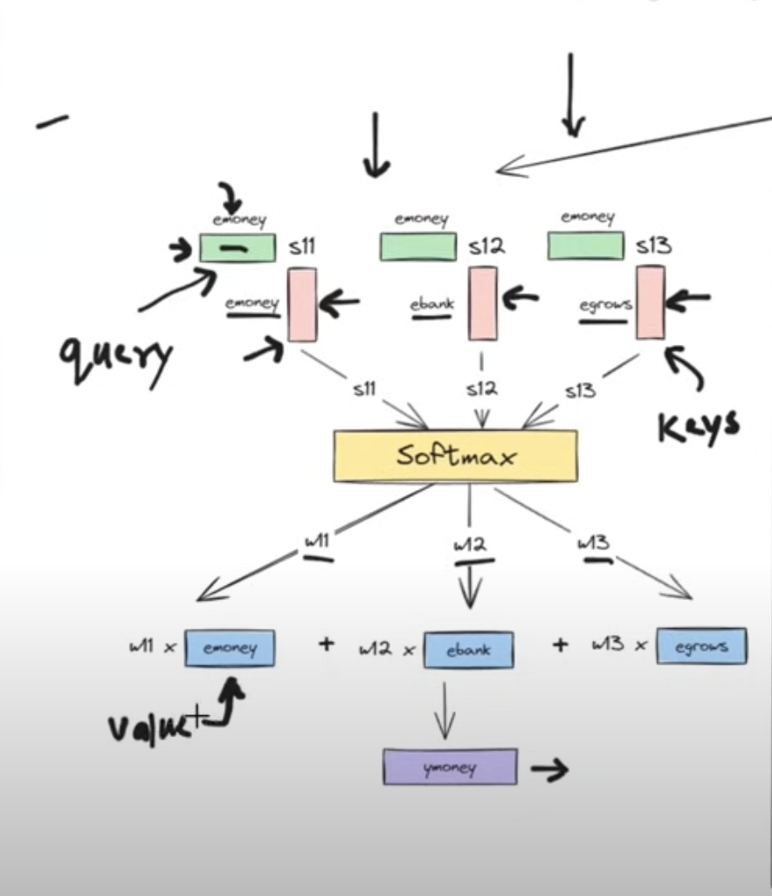
Query , Key, Value
Separation of concerns, components of the same word
By applying separate linear transformations to generate Q, K, and V vectors from the same input, the model learns distinct aspects of the data, enabling it to capture various relationships and patterns within the sequence.
Basically you get to pick what the model “sees”, then what the model “responds” with.

Slide 8
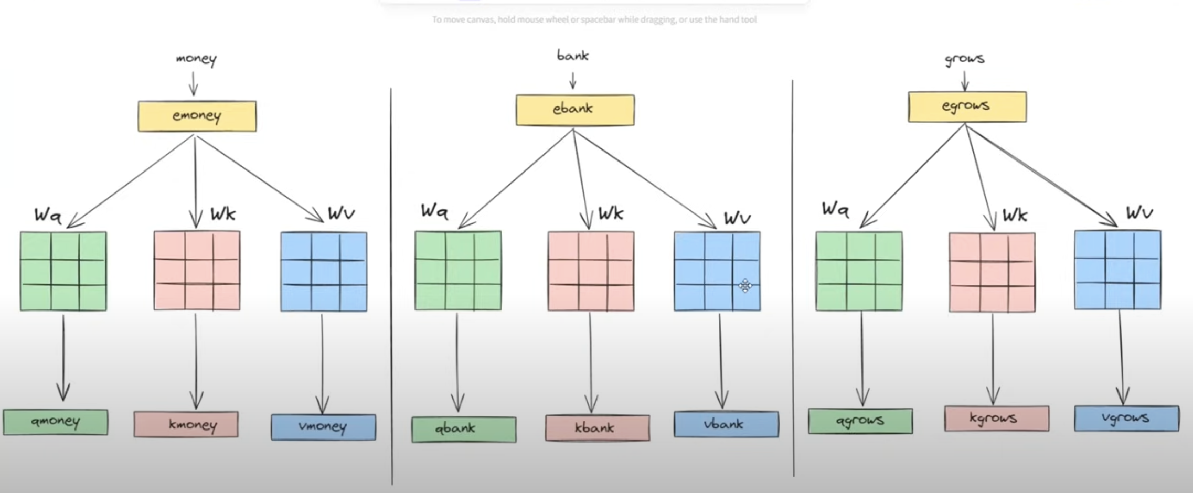

Slide 9
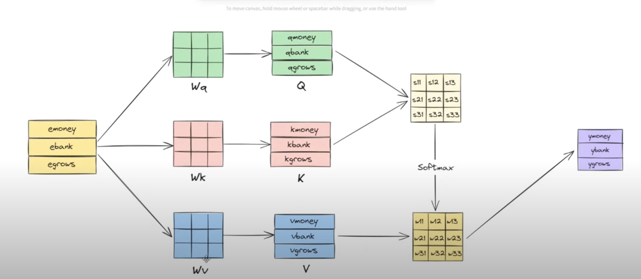

Slide 10
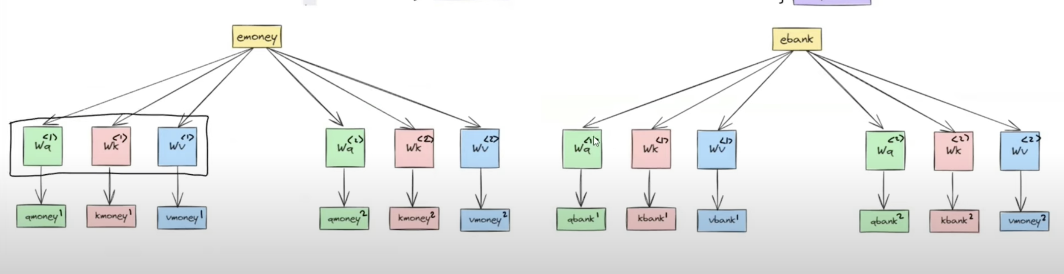
Multi-head attention

Slide 11
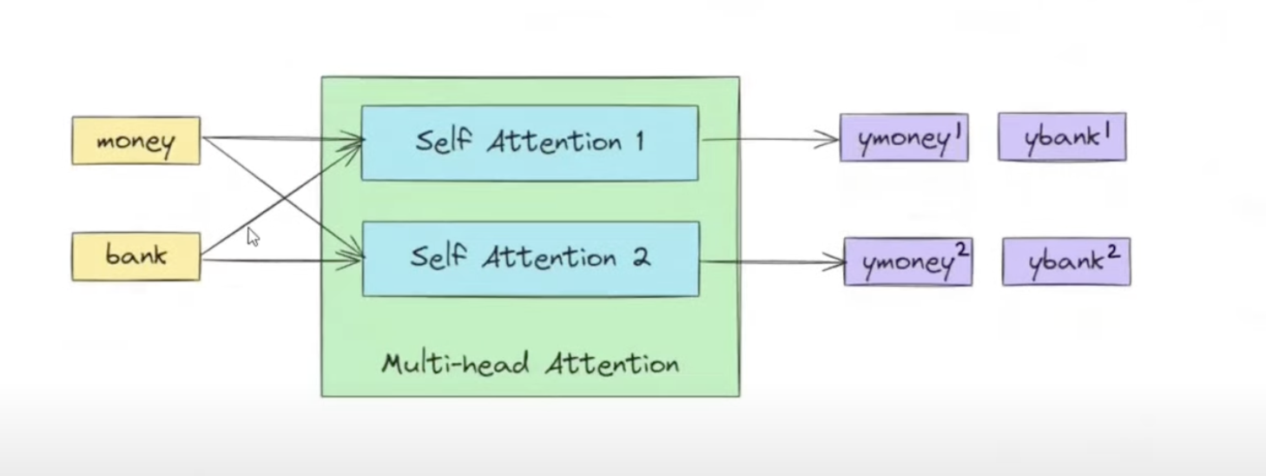

Slide 12
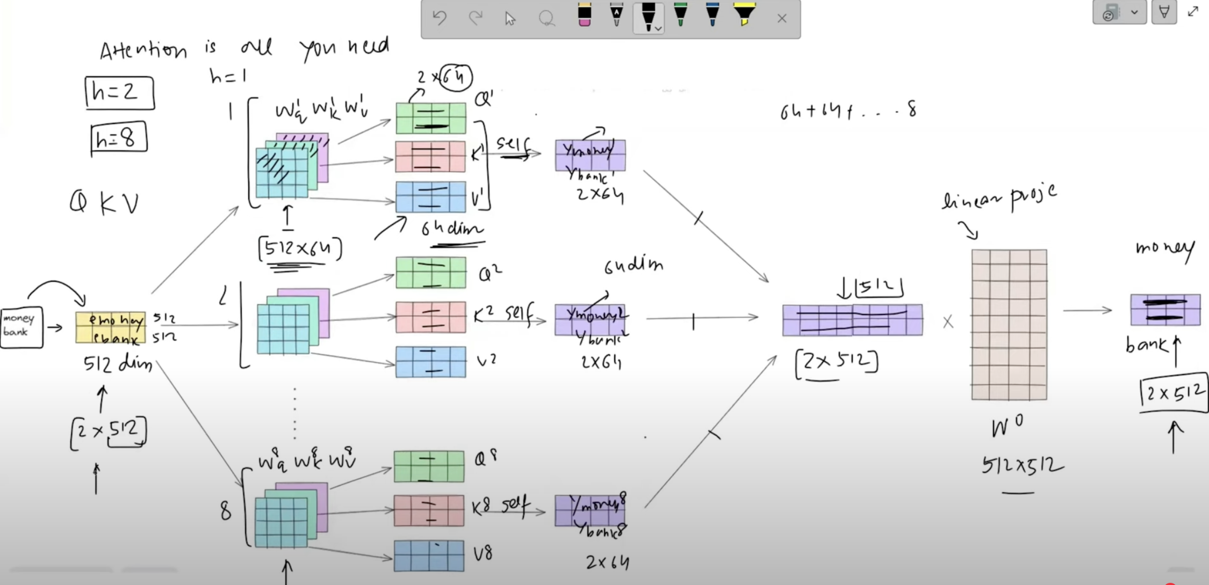

Slide 13
Positional Encoding Solution
- Counting words directly → unbounded values → vanishing gradient
- Discrete positional values → poor gradient flow
- Solution: Use a periodic function (trigonometric functions)

Slide 14
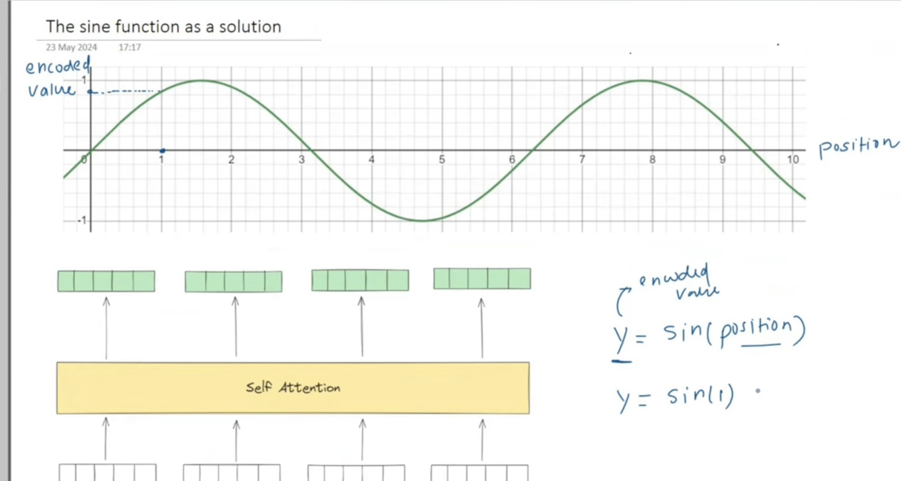
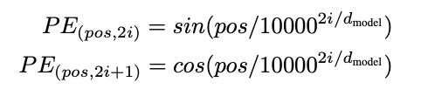
Positional Encoding

Slide 15
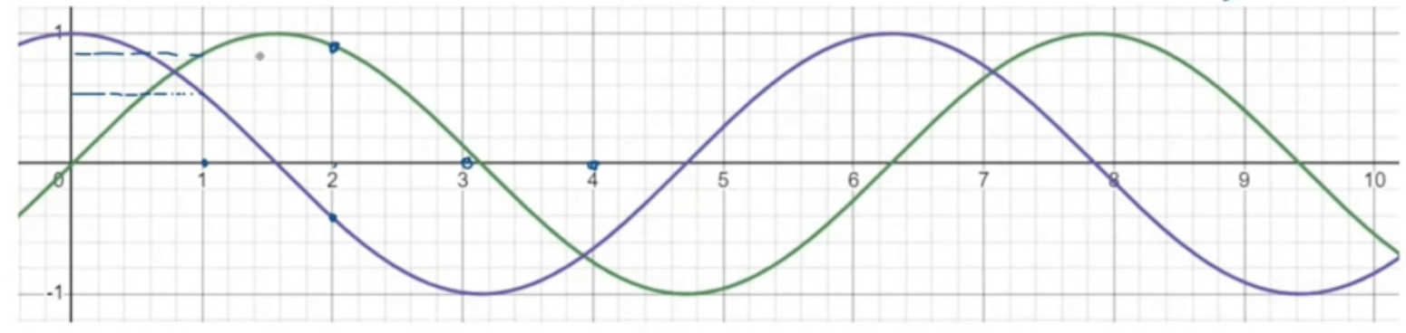
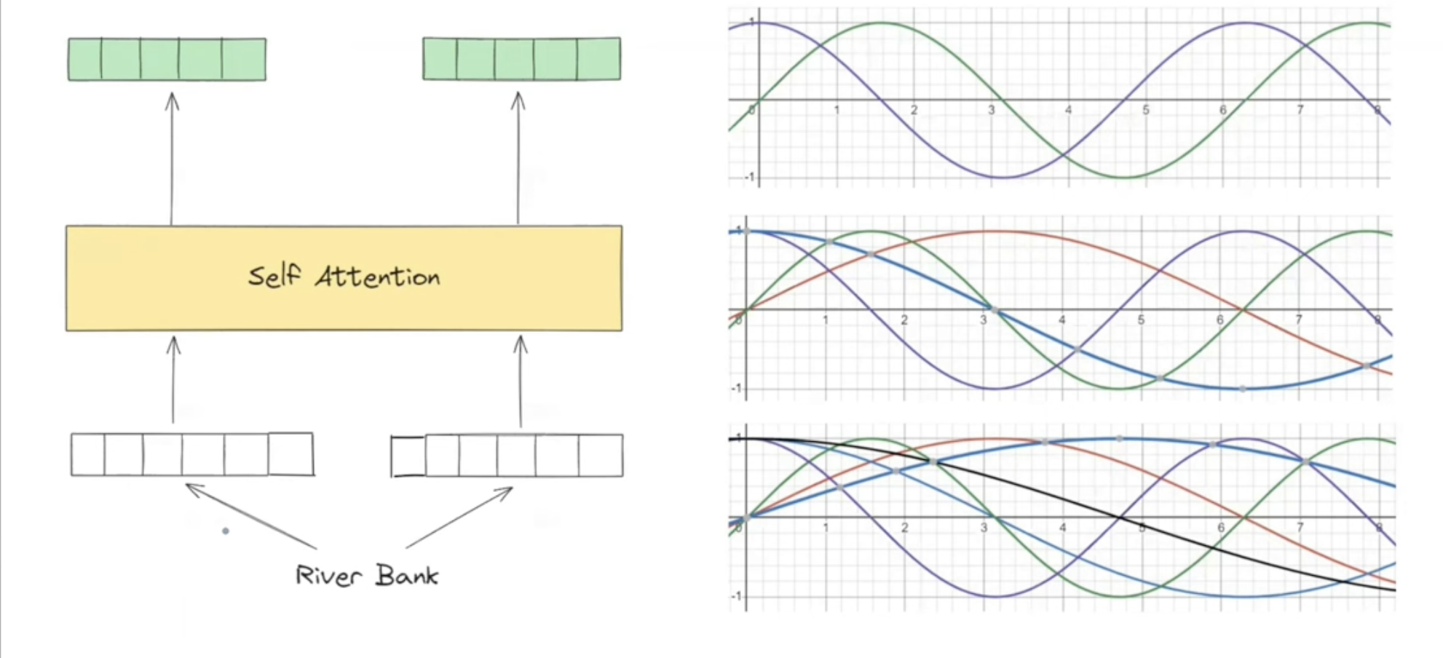

Slide 16
Trigonometric Functions in Positional Encoding
Uses sine and cosine functions
Ensures bounded, continuous, periodic encoding
Example:
- sin(pos/10000^(2i/d)) for even indices
- cos(pos/10000^(2i/d)) for odd indices
Allows model to understand word order and relative positioning

Slide 17
Final Step: Combining Embeddings and Positional Encoding
Positional encoding vector is same dimension as word embeddings
Added to embeddings before feeding into self-attention mechanism
This allows model to consider both meaning and word order

Slide 18
Normalization
Normalization ensures stable training by reducing extreme values, enabling faster convergence, and mitigating internal covariate shift.
Covariate shift occurs when the input data distribution differs from the prediction data distribution, e.g., training on red roses but predicting on yellow roses.
Internal covariate shift happens in hidden layers as their weights change over time, causing fluctuations in input distributions.

Slide 19
Encoder
Feed-forward network:
- 1st layer: 2048 neurons, ReLU activation
- 2nd layer: 512 neurons, Linear activation
Residual layers stabilize training and help mitigate the vanishing gradient problem, inspired by ResNet.

Slide 20
Decoder
The decoder is autoregressive at inference time but not during training due to masked self-attention.
Generate sequences step by step, conditioning on previous outputs.
During training, the model should not see future tokens. Masking ensures proper sequence learning.

Slide 21
Masked Multi-head Attention
We prevent the model from seeing future words (to avoid cheating).
We do this by setting certain attention scores to -∞ (effectively masking them out).

Slide 22
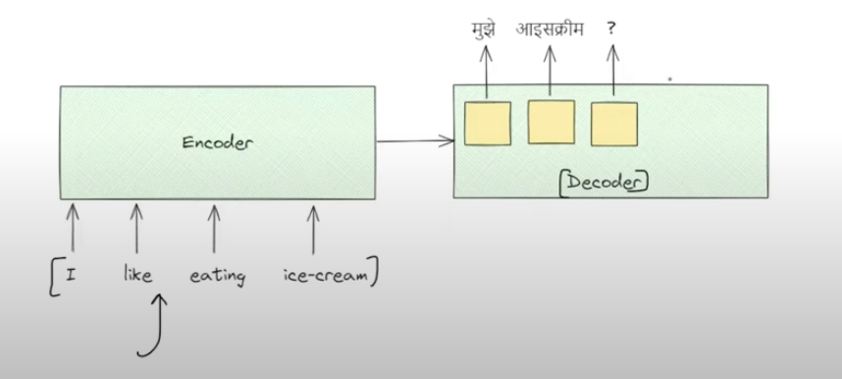
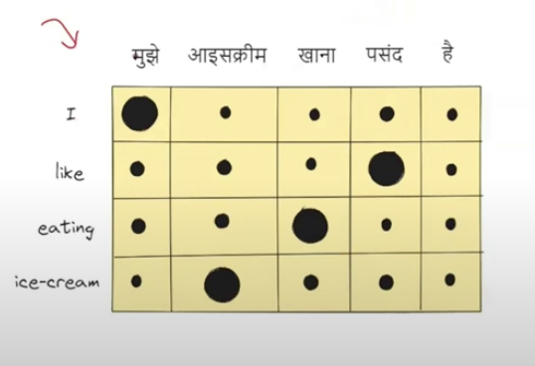
Cross Attention

Slide 23
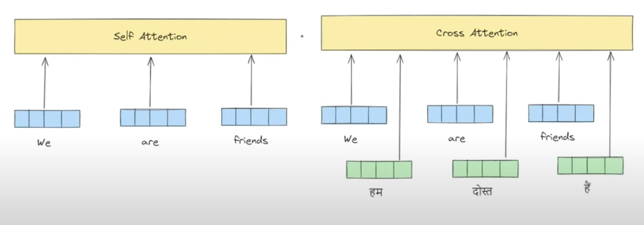

Slide 24
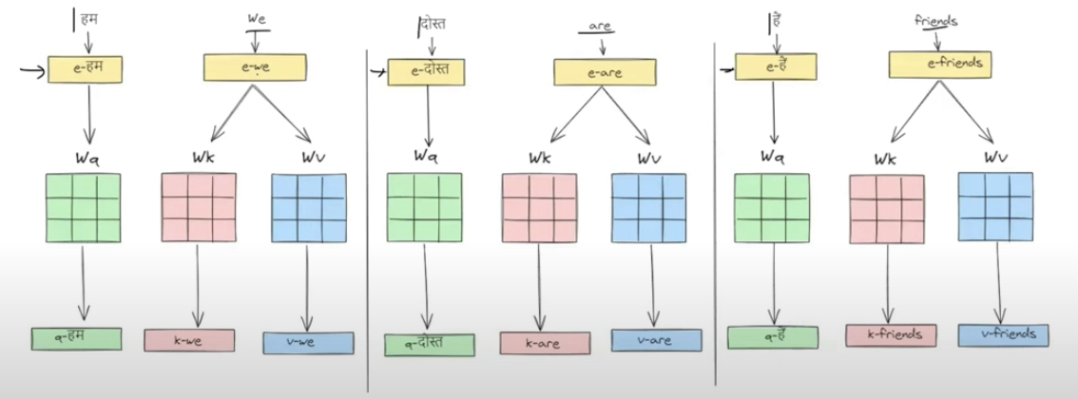
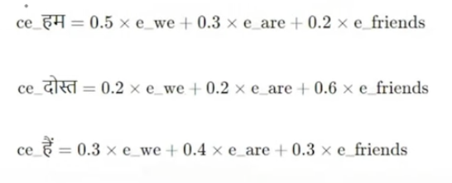

Slide 25
During training, we use teacher forcing (providing correct words).
During inference, the model generates words one-by-one (autoregressive behavior).
After passing through multiple decoder layers, the output is projected onto the vocabulary space.
Softmax determines the most probable next word.
The process repeats until an token is generated.

Slide 26
